Slide 1
MODULE 3
Control Structures

Slide 2
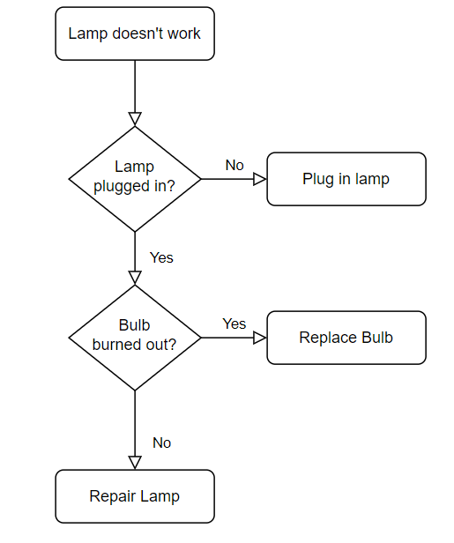
Condition

Slide 3
Decision Making and Branching
When problem involves decision making to do specific task conditional statements can be used.
The following are the conditional statements provided by Python.
if
if-else
nested if
if-elif statements

Slide 4
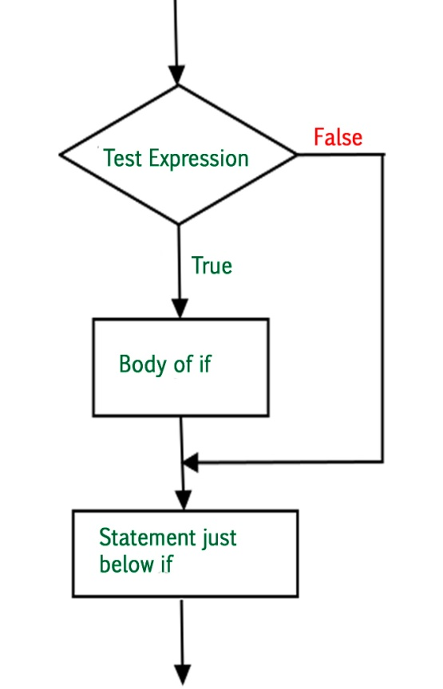
if - Statement
Condition must be a statement that evaluates to a boolean value (True or False).
Syntax:
if test_expression/condition:
statements
Ends with Colon
Note: If the condition is false , this “if statement” is skipped

Slide 5
Example 1
# if statement example
if 10 > 5:
print("10 greater than 5")
print("Program ended")
Output:
10 greater than 5
Program ended
Indentation
Indentation(White space) is used to delimit the block of code. As shown in the above example it is mandatory to use indentation in Python3 coding.

Slide 6
Example 2
x = 5
x < 10 ?
Yes
Program:
x = 5
if x < 10:
print('Smaller')
if x > 20:
print('Bigger')
print('Finish')
No
print('Smaller')
Output:
Smaller
Finish
x > 20 ?
Yes
No
print('Bigger')
print('Finish')

Slide 7
Comparison Operators
Boolean expressions ask a question and produce a Yes or No result which we use to control program flow
Boolean expressions using comparison operators evaluate to True / False or Yes / No
Comparison operators look at variables but do not change the variables
Python | Meaning
< | Less than
<= | Less than or Equal to
== | Equal to
>= | Greater than or Equal to
> | Greater than
!= | Not equal
Remember: “=” is used for assignment.

Slide 8
Example 3
x = 5
if x == 5 :
print('Equals 5')
if x > 4 :
print('Greater than 4')
if x > 5 :
print('Greater than 5')
if x > 6 : print(‘Greater than 6')
if x <= 5 :
print('Less than or Equals 5')
if x != 6 :
print('Not equal 6')
OUTPUT
Equals 5
Greater than 4
Less than or Equals 5
Not equal 6

Slide 9
Example 4
x = 5
print('Before 5')
if x == 5 :
print('Is 5')
print('Is Still 5')
print('Third 5')
print('Afterwards 5')
print('Before 6')
if x == 6 :
print('Is 6')
print('Is Still 6')
print('Third 6')
print('Afterwards 6')
Yes
x == 5 ?
Before 5
Is 5
Is Still 5
Third 5
Afterwards 5
Before 6
Afterwards 6
No
print('Is 5’)
print('Still 5')
print('Third 5')
One way decision

Slide 10
Example 5
Write a Python program that checks if the word "World" is present in the string “s”. If the word "World" is found, append an exclamation mark to the string s. Finally, print the modified string.
Note: Use if statement
Input :
Hello World
Output:
Hello World!

Slide 11
Example 5
# if statement example
s = "Hello World"
if "World" in s:
s=s+"!"
print(s)
Output:
Hello World!

Slide 12
Nested if
x=42
x = 42
if x > 1 :
print('More than one')
if x < 100 :
print('Less than 100')
print('All done')
x > 1
yes
no
print('More than one’)
x < 100
yes
no
print('Less than 100')
Output:
More than one
Less than 100
All done
print('All Done')

Slide 13
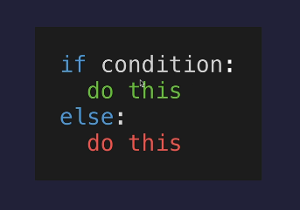
if else statement
It has both true and false blocks. Either true or false block would be executed based on the condition evaluation of the if statement.
Syntax:
if test_expression:
statements
else:
statements

Slide 14
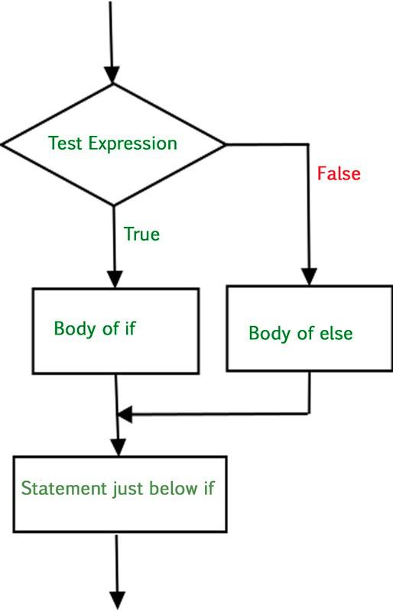

Slide 15
Example 1
x = 4
Two way decision
x = 4
if x > 2 :
print('Bigger')
else :
print('Smaller')
print('All done')
x > 2
no
yes
print('Not bigger')
print('Bigger')
print('All Done')
Output:
Bigger
All done

Slide 16
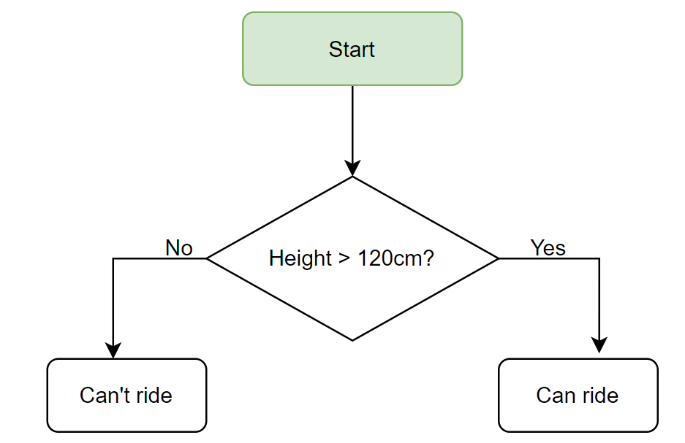
Write a code to ride a rollercoaster based on the condition stated in the flowchart.

Slide 17
Example 2
Write a Python program that defines a variable x and sets it to the value 1000. Use an if-else statement to check if x is less than 100. If x is less than 100, print "x is less than 100". Otherwise, print "The value of x is 1000". Finally, print "End of Program".

Slide 18
Example 2
# if else statement example
x = 1000
if (x<100):
print(“x is less than 1000")
else:
print(“The value of x is 1000")
print ("End of Program")
Output:
The value of x is 1000
End of Program

Slide 19
Example 3
Check whether the number is odd or even
# if else statement example
N=int(input("Enter n:"))
if (N%2==0):
print(N,"is even")
else:
print(N,"is Odd")
Output:
Enter n: 5
5 is Odd

Slide 20
Nested if else statement
if statement can also be checked inside other if statement.
This conditional statement is called nested if statement.
This means that inner if condition will be checked only if outer if condition is true and by this, we can see multiple conditions to be satisfied.

Slide 21
Nested if else statement
Syntax:
if test_expression:
if test_expression:
statements
else:
statements
else:
Body of else

Slide 22
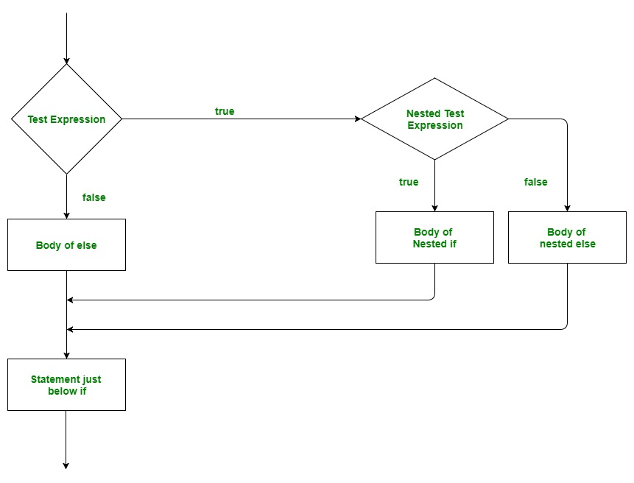
Multi way decision

Slide 23
Example 1
# NESTED IF ELSE statement example
x = 20
y = 30
if x>=y:
print("x is greater than y")
if x==y:
print("x is equal to y")
else:
print("x is greater than y")
else:
print("x is smaller than y")
Output:
x is smaller than y

Slide 24
if else CHAIN statement
Syntax:
if test_expression:
statement 1
else:
if test_expression:
statement 2
else:
statements

Slide 25
Example 1
# IF ELSE CHAIN statement example
letter = "A"
if letter == "B":
print("letter is B")
else:
if letter =="C":
print("letter is C")
else:
if letter == "A":
print("letter is A")
else:
print("letter is neither A,B or C")
Output:
letter is A

Slide 26
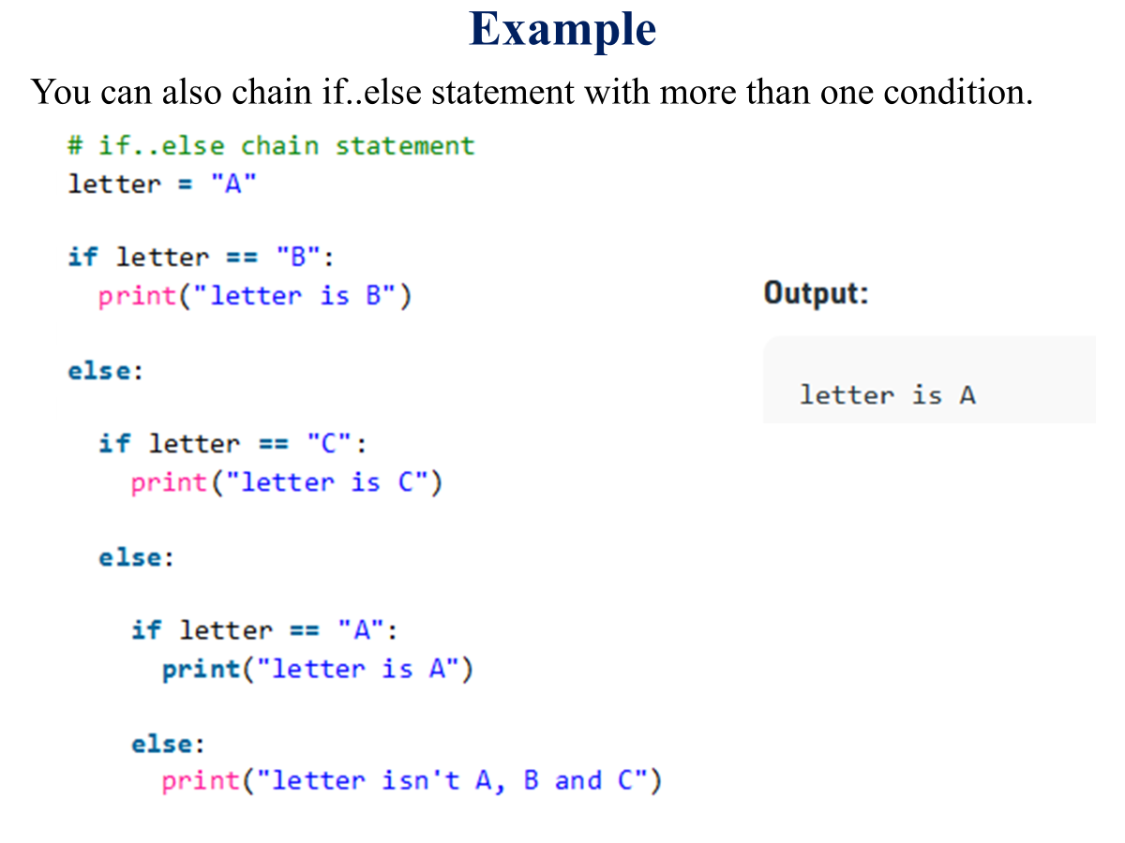

Slide 27
if-elif-else statement
The if-elif statement is shortcut of if..else chain.
While using if-elif statement at the end else block is added which is performed if none of the above if-elif statement is true.

Slide 28
if-elif-else statement
Syntax:
if test_expression:
statement 1
elif test_expression :
statement 2
elif test_expression :
statement 3
. .
. .
else:
body of else

Slide 29
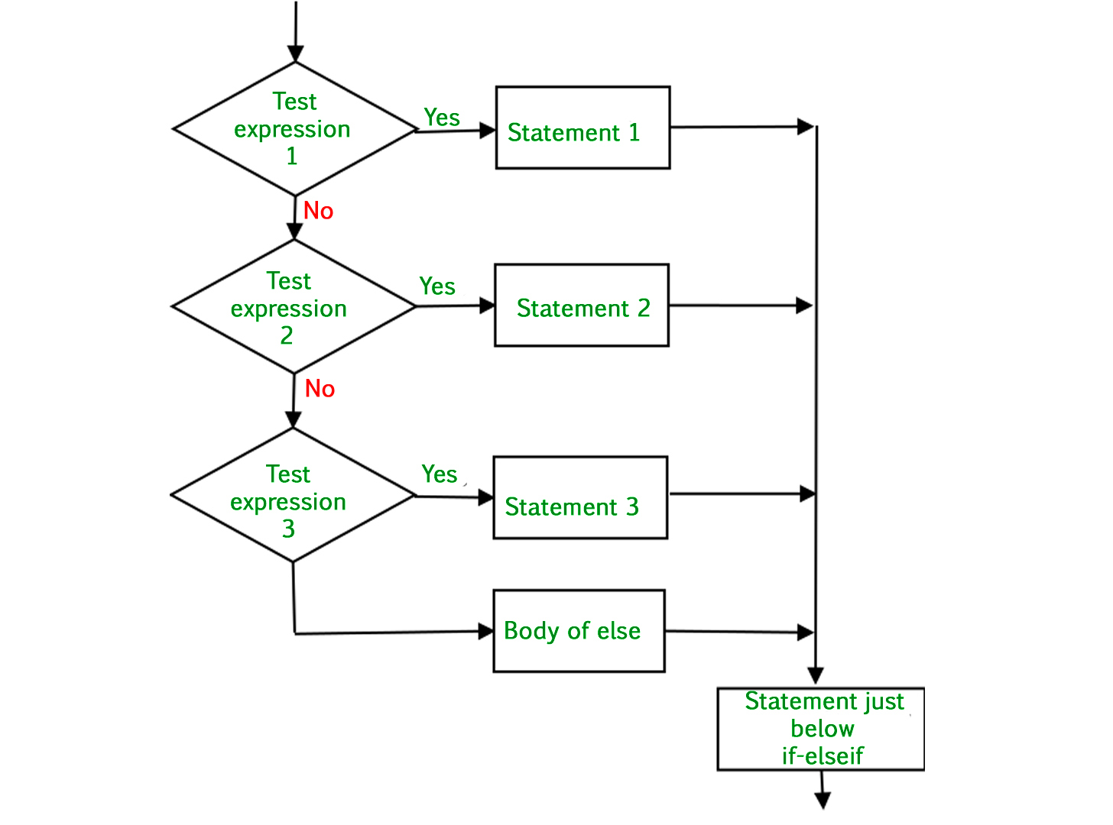
if-elif-else statement

Slide 30
Example 1
x = 20
x = int(input("enter x:"))
if x < 2 :
print('small')
elif x < 10 :
print('Medium')
else :
print('LARGE')
print('All done')
yes
x < 2
print('small')
no
yes
x < 10
print('Medium')
no
print('LARGE')
Output:
enter x:20
LARGE
All done
print('All Done')
Multi way decision

Slide 31
Example 2
# if elif else statement example
i = 25
if (i == 10):
print("i is 10")
elif (i == 15):
print("i is 15")
elif (i == 20):
print("i is 20")
else:
print("i is greater than 20")
Output:
i is greater than 20

Slide 32
Example 3
# if elif else statement example
letter = "D"
if letter == "B":
print("letter is B")
elif letter =="C":
print("letter is C")
elif letter == "A":
print("letter is A")
else:
print("letter is neither A,B or C")
Output:
letter is neither A,B or C

Slide 33
Multiple Conditions
Multiple conditions can be checked in a ‘if’ statement using logical operators ‘and’ and ‘or’.
Python code to print ‘excellent’ if mark1 and mark2 is greater than or equal to 90, print ‘good’ if mark1 or mark2 is greater than or equal to 90, print ‘need to improve’ if both mark1 and mark2 are lesser than 90

Slide 34
Example 1
# multiple condition example
mark1 = int(input("Enter mark1:"))
mark2 = int(input("Enter mark2:"))
if mark1>=90 and mark2>=90:
print("excellent")
if mark1>=75 or mark2 >= 80:
print("good")
else:
print("needs to improve")
Output:
Enter mark1:20
Enter mark1:60
needs to improve

Slide 35
Task
Write a program to print the largest of 3 numbers.
Write a program to check whether a person is eligible to vote or not. [The person should be above 18]
Write a program to find whether a year is a leap year.
Write a python program to segregate student based on their CGPA. The details are as follows:
<=9 CGPA <=10 - outstanding
<=8 CGPA <9 - excellent
<=7 CGPA <8 - good
<=6 CGPA <7 - average
<=5 CGPA <6 - better
CGPA<5 - poor

Slide 36
Task
Write a Python program to create a simple login system.
The program should:
1. Define a predefined username and password.
2. Prompt the user to enter their username and password.
3. Check if the entered username and password match the predefined ones.
4. Display a success message if the login credentials are correct.
5. Display an error message if the login credentials are incorrect.

Slide 37
Calculate the current GMT time
import time
current_time=time.time() #get current time
tseconds=int(current_time)
csecond=tseconds%60
tminutes=tseconds//60
cminute=tminutes%60
thours=tminutes//60
chour=thours%24
#print("Current time is", chour,":",cminute,":",csecond,"GMT")
print(f"Current time is {chour:02}:{cminute:02}:{csecond:02} GMT")

Slide 38
Need of Iterative Control
Repeated execution of set of statements
An iterative control statement is a control statement providing repeated execution of a set of instructions
Because of their repeated execution, iterative control structures are commonly referred to as “loops”.

Slide 39
Iterative Control Statements
while statement (indefinite)
Repeatedly executes a set of statements based on a condition.
Ideal when stop criteria is not explicit
for statement (definite)
Repeatedly executes a set of statements until the sequence is exhausted

Slide 40
while
Syntax
while loop-condition: # Loop test statement(s) # Loop body
while statement in Python, executes the statements within the while loop as long as the while condition is true.

Slide 41
While loop
Repeat a specific block of code
Used to iterate over a block of code as long as the test expression (condition) is true
While loop when we don't know the number of times to iterate beforehand

Slide 42
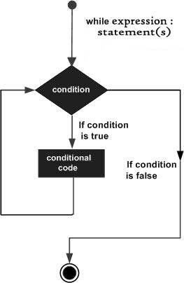
Example 1: Print values from 1 to N
N=int(input())
a =1
while a <= N:
print(a)
a = a + 1
Iteration | a | a<=3 | Print a | a=a+1
1 | 1 | True | 1 | counter=1+1 ->(2)
2 | 2 | True | 2 | counter=2+1 ->(3)
3 | 3 | True | 3 | counter=3+1 ->(4)
4 | 4 | False | loop termination

Slide 43
Example 2
n = 5
Program:
n = 5
while n > 0 :
print(n)
n = n – 1
print('Blastoff!')
print(n)
Output:
5
4
3
2
1
Blastoff!
0
No
n > 0 ?
Yes
print(n)
n = n -1
print('Blastoff')
Loops (repeated steps) have iteration variables that change each time through a loop. Often these iteration variables go through a sequence of numbers.

Slide 44
Example 3: Print values from 90 to 100 in a line
a=90
b=100
while a < b:
print(a, end=' ')
a = a+1
Output:
90 91 92 93 94 95 96 97 98 99

Slide 45

Example 4: If-else in while loop
Print even and odd numbers between 1 to the entered number
CODE
n = int(input("Enter a number:"))
while n>0:
if n%2==0:
print(n, "is even")
else:
print(n, "is odd")
n = n-1
OUTPUT
Enter a number:5
5 is odd
4 is even
3 is odd
2 is even
1 is odd

Slide 46
Example 3
Write a program to reverse the number received from the user
Input: 14786
Output:68741

Slide 47
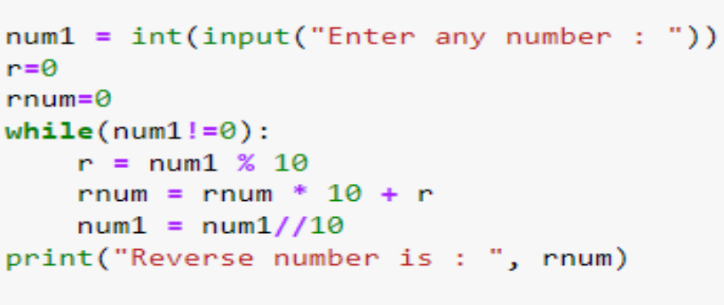
Example 3-solution

Slide 48
Tasks
Print a two table
Sum of first 10 even numbers
Add the successive cubic roots for an input N….. Ex: 1+8+27=36.(N=3)
Write a program to display all the numbers which are divisible by 13 but not by 3 between 100 and 500 (exclude 100 and 500)
Check for palindrome

Slide 49
Definite Loop
Quite often we have a list of items in a file - effectively known as finite set of things
We can write a loop to run the loop once for each of the items in a set using the Python for construct
These loops are called “definite loops” because they execute an exact number of times
We say that “definite loops iterate through the members of a set”

Slide 50
For loop
Repeatedly executes a set of statements until the sequence is exhausted
Python sequences
String – a sequence of characters
range
List, Tuple

Slide 51
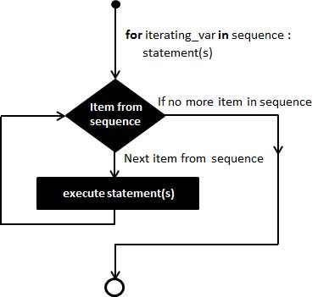
For loop
A for loop is used for iterating over a sequence (that is either a list, a tuple, a dictionary, a set, or a string).
With the for loop we can execute a set of statements, once for each item in a list, tuple, set etc.
Syntax:
for var in iterable:
# statements

Slide 52
A Simple FOR Loop
Example 1
OUTPUT
5
4
3
2
1
Blastoff!
for i in [5, 4, 3, 2, 1] :
print(i)
print('Blastoff!')

Slide 53
Example 2
Calculate the square of each number of list
Output:
Square of 1 is 1
Square of 2 is 4
Square of 3 is 9
Square of 4 is 16
Square of 5 is 25
CODE
numbers = [1,2,3,4,5]
for i in numbers:
square = i**2
print("Square of ", i , "is", square)

Slide 54
Example 3
For and Strings
CODE
for i in "python":
print("The letter is", i)
OUTPUT
The letter is p
The letter is y
The letter is t
The letter is h
The letter is o
The letter is n

Slide 55
Example 4
CODE
names = ['Ram', 'Raj', 'Rak']
for i in names:
print("Name:", i)
OUTPUT
Name: Ram
Name: Raj
Name: Rak

Slide 56
For loop
Example:
fruits = ["apple", "banana", "cherry"] for x in fruits: print(x)
print("String Iteration")
s = "Geeks"
for i in s:
print(i)

Slide 57
For and dictionaries
data1 = {0:'hi',1:'a',2:1,3:5.5,4:200.1,5:'do'}
data2 = {'no',.9}
for x in data1.keys():
print(data1[x])

Slide 58
For loop
for i in
(0, 10, 2):
(i)
Example:1
for i in range(0, 10, 2):
print(i)
Example:2
for i in range(1, 4):
for j in range(1, 4):
print(i, j)
Example 3:
Numbers =[x for x in range(11)]
print(Numbers)

Slide 59
Example 4:
data1 = {0:'hi',1:'a',2:1,3:5.5,4:200.1,5:'do'}
data2 = {'no',.9}
for x in data1.keys():
print(data1[x])
Example 5:
cars = ['audi', 'bmw', 'subaru', 'toyota']
for car in cars:
if car == 'bmw':
print(car.upper())
else:
print(car.title())

Slide 60
Range
Syntax - range( begin,end,step) where
Begin - first value in the range; if omitted, then default value is 0
end - one past the last value in the range; end value may not be omitted
Step - amount to increment or decrement; if this parameter is omitted, it defaults to 1 and counts up by ones
begin, end, and step must all be integer values;
floating-point values and other types are not allowed

Slide 61
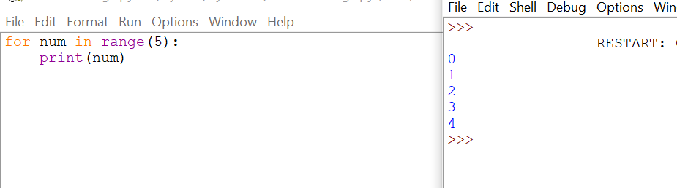
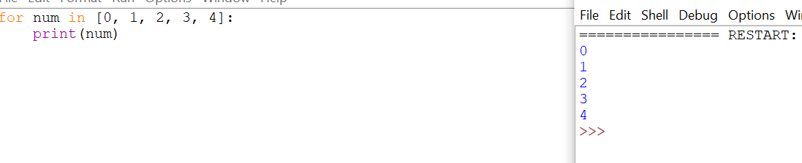

Slide 62
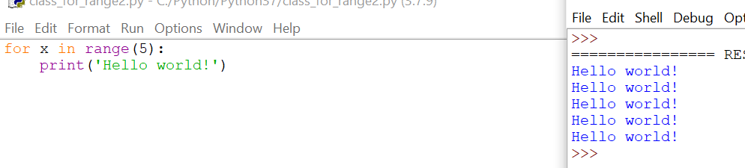

Slide 63
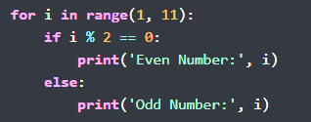
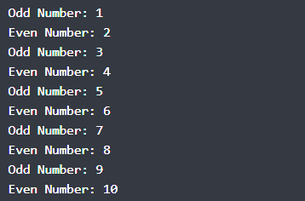
If-else in for loop
Example: Print all even and odd numbers
Output

Slide 64
Additional example
mystr= “Hello World”
For i in enumerate(mystr):
print(i)
Note: list(enumerate(mystr1))

Slide 65
Using Else Conditional Statement With For loop
for i in range(1, 4):
print(i)
else: # Executed because no break-in for
print("No Break")
Note: The else block just after for/while is executed only when the loop is NOT terminated by a break statement.

Slide 66
for i in range(1, 4):
print(i)
break
else: # Not Executed as there is a break print("No Break")

Slide 67
Nested loops
x = [1, 2]
y = [4, 5]
i = 0
while i < len(x) :
j = 0
while j < len(y) :
print(x[i] , y[j])
j = j + 1
i = i + 1
x = [1, 2]
y = [4, 5]
for i in x:
for j in y:
print(i, j)

Slide 68
Printing multiplication table using nested for loops
Print 2 and 3 tables in the range of 1 to 11

Slide 69
Printing multiplication table using nested for loops
for i in range(2,4):
for j in range (1,12):
print(i,"*",j,"=",i*j)
print()

Slide 70
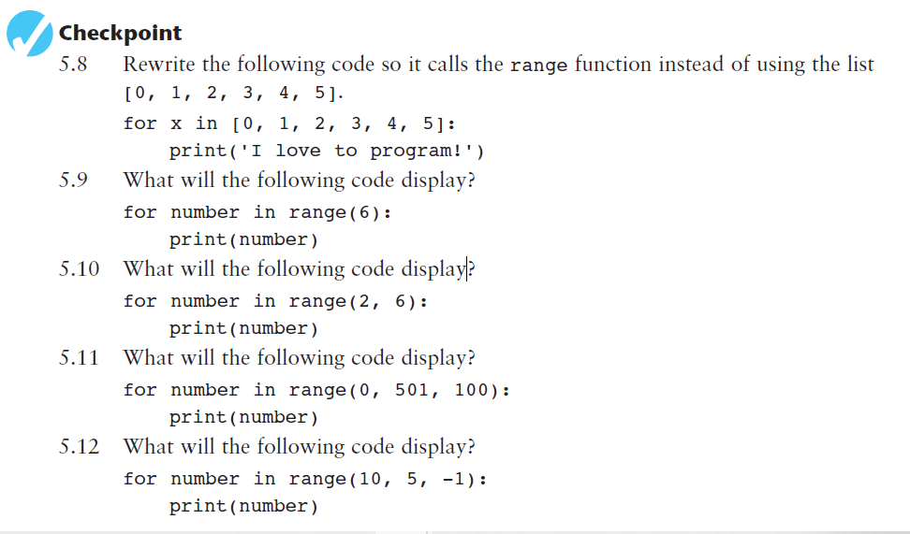
Task

Slide 71
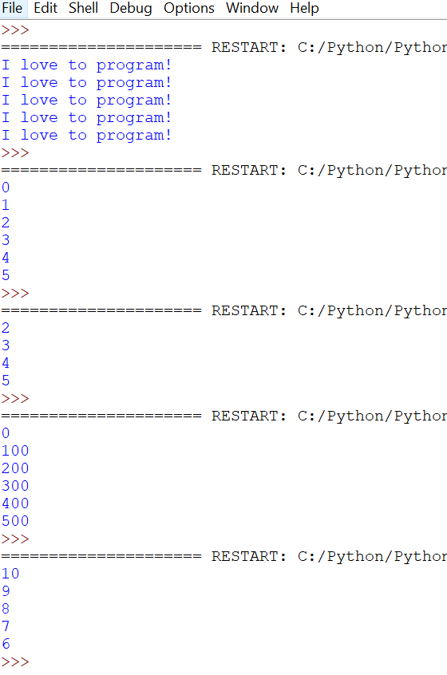
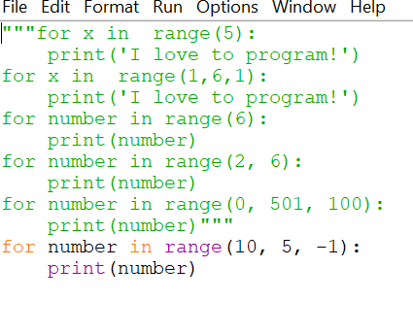

Slide 72
Loop Control Statement
Loop control statements change the execution of the loop from its normal sequence.
Python follows
Break statement: used to exit the loop
Continue statement: used to skip once, i.e one iteration
pass statement: to execute once

Slide 73
fruits=["apple","mango","banana","cherry","orange"]
for items in fruits:
if items=="banana":
break
else:
print(items)
fruits=["apple","mango","banana","cherry","orange"]
for items in fruits:
if items=="banana":
continue
else:
print(items)
fruits=["apple","mango","banana","cherry","orange"]
for items in fruits:
if items=="banana":
pass
else:
print(items)

Slide 74
for num in range(0,10):
if num == 5:
continue
print(f'Iteration: {num}')
for num in range(0,10):
if num == 5:
pass
print(f'Iteration: {num}')

Slide 75
Break statement
The break statement is used inside the loop to exit out of the loop.
In Python, when a break statement is encountered inside a loop, the loop is immediately terminated, and the program control transfer to the next statement following the loop.
For example, you are searching a specific email inside a file. You started reading a file line by line using a loop. When you find an email, you can stop the loop using the break statement.
We can use Python break statements in both for loop and while loop.
It reduces execution time.

Slide 76
Continue statement
Continue statement forces to execute the next iteration of the loop while skipping the rest of the code inside the loop for the current iteration only.
It can be used in both while and for loops.

Slide 77
Pass statement
Pass is used to execute nothing; it means when we don't want to execute code, the pass can be used to execute empty
It just makes the control pass by without executing any code.
If we want to bypass any code, a pass statement can be used.
The difference between the comments and pass is that comments are entirely ignored by the Python interpreter, whereas the pass statement is not ignored

Slide 78
Example 4: An Infinite Loop
n = 5
No
n > 0 ?
Yes
n = 5
while n > 0 : print('Lather')
print('Rinse')
print('Dry off!')
print('Lather')
print('Rinse')
print('Dry off!')
What is wrong with this loop?

Slide 79
Example 5
n = 0
No
n > 0 ?
Yes
n = 0
while n > 0 :
print('Lather')
print('Rinse')
print('Dry off!')
print('Lather')
print('Rinse')
What is this loop doing?
print('Dry off!')

Slide 80
Summary
break
Jumps out of the closest enclosing loop
continue
Jumps to the top of the closest enclosing loop
pass
Does nothing at all: it’s an empty statement placeholder

Slide 81
Example
List of months: January, February, March, April, May, June, July, August, September, October, November, December
Input the name of Month: April
No. of days: 30 days

Slide 82
# Display a list of months to the user
print("List of months: January, February, March, April, May, June, July, August, September, October, November, December")
# Request input from the user to enter the name of a month and assign it to the variable 'month_name’
month_name = input("Input the name of Month: ")
# Check the input 'month_name' and provide the number of days based on the entered month
if month_name == "February":
print("No. of days: 28/29 days") # Display the number of days in February (28 or 29 days for leap years)
elif month_name in ("April", "June", "September", "November"):
print("No. of days: 30 days") # Display the number of days for months having 30 days
elif month_name in ("January", "March", "May", "July", "August", "October", "December"):
print("No. of days: 31 days") # Display the number of days for months having 31 days
else:
print("Wrong month name") # If the entered month name doesn't match any of the above conditions, display an error message

Slide 83
Fibonacci series
n = 10
num1 = 0
num2 = 1
next_number = num2
count = 1
while count <= n:
print(next_number, end=" ")
count += 1
num1, num2 = num2, next_number
next_number = num1 + num2
print()

Slide 84
Python program to find the factorial of a given number.
# given number
given_number= 5
# since 1 is a factor of all number set the factorial to 1
factorial = 1
# iterate till the given number
for i in range(1, given_number + 1):
factorial = factorial * i
print("The factorial of ", given_number, " is ", factorial)

Slide 85
Write a Python code to check if the given
mobile number is valid or not. The conditions
to be satisfied for a mobile number are:
a) Number of characters must be 10
b) All characters must be digits and must not
begin with a ‘0’

Slide 86
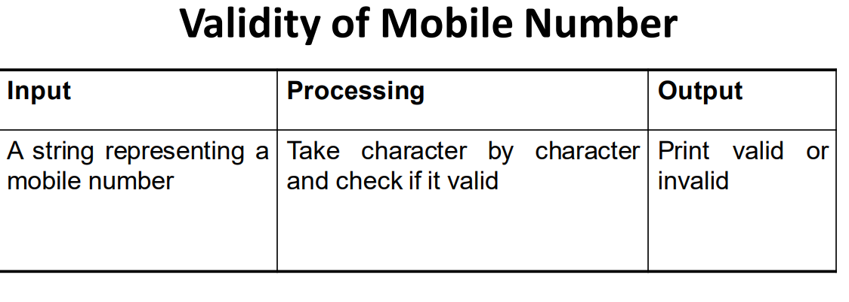
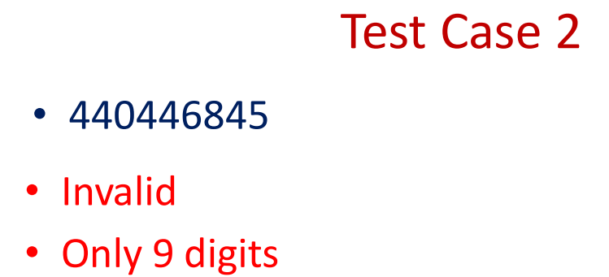
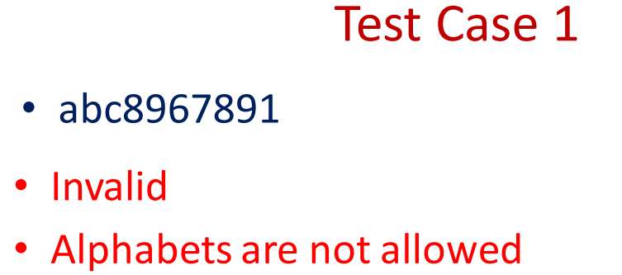

Slide 87
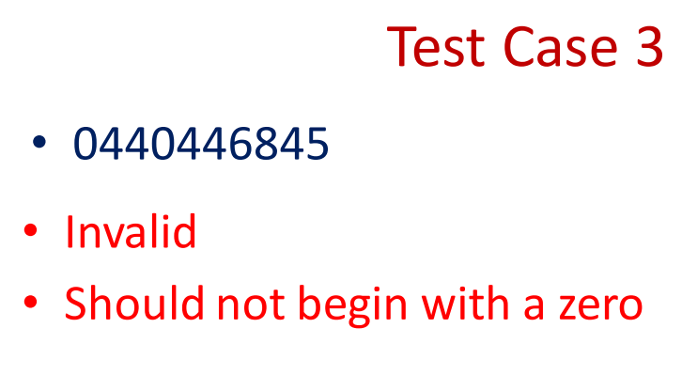
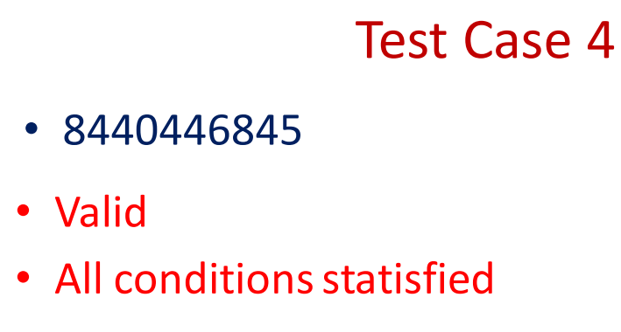

Slide 88
# Prompt the user to input a mobile number
mobile_number = input("Enter your mobile number: ")
# Initialize a flag to check validity
is_valid = True
# Check if the length is exactly 10
if len(mobile_number) != 10:
is_valid = False
# Check if the first character is '0'
if mobile_number[0] == '0':
is_valid = False

Slide 89
# Check if all characters are digits
for char in mobile_number:
if char < '0' or char > '9': # This checks if the character is not a digit
is_valid = False
break
# Output whether the mobile number is valid or not
if is_valid:
print("The mobile number is valid.")
else:
print("The mobile number is not valid.")

Slide 90
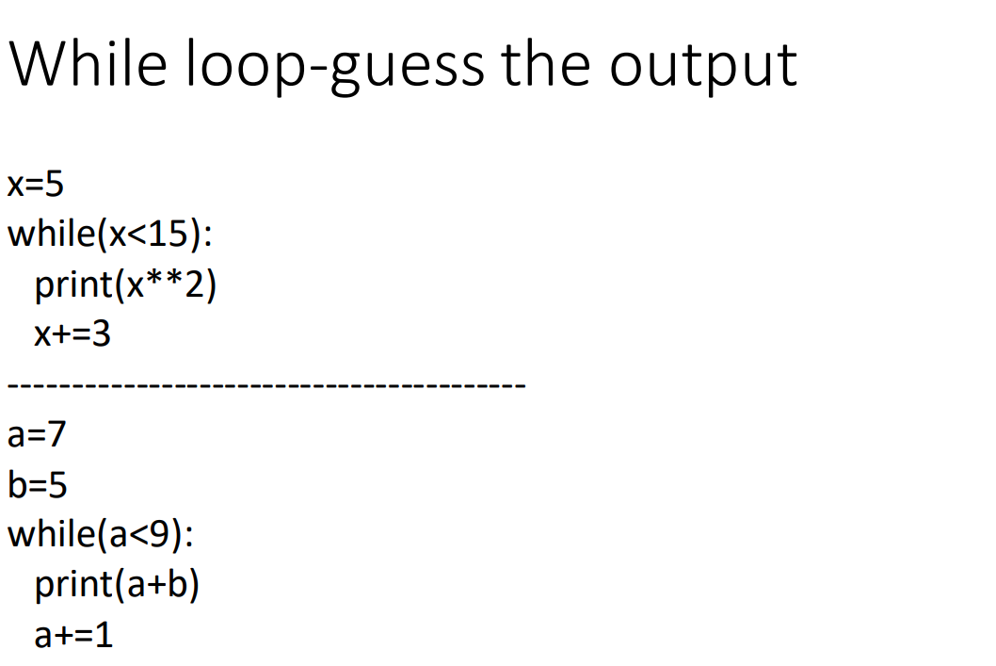

Slide 91
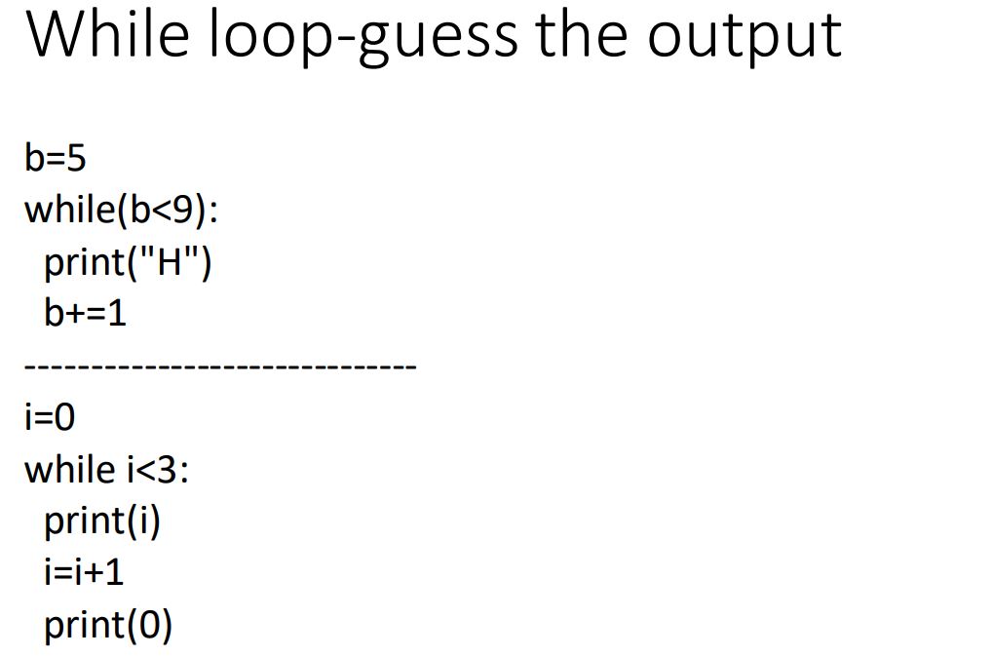

Slide 92
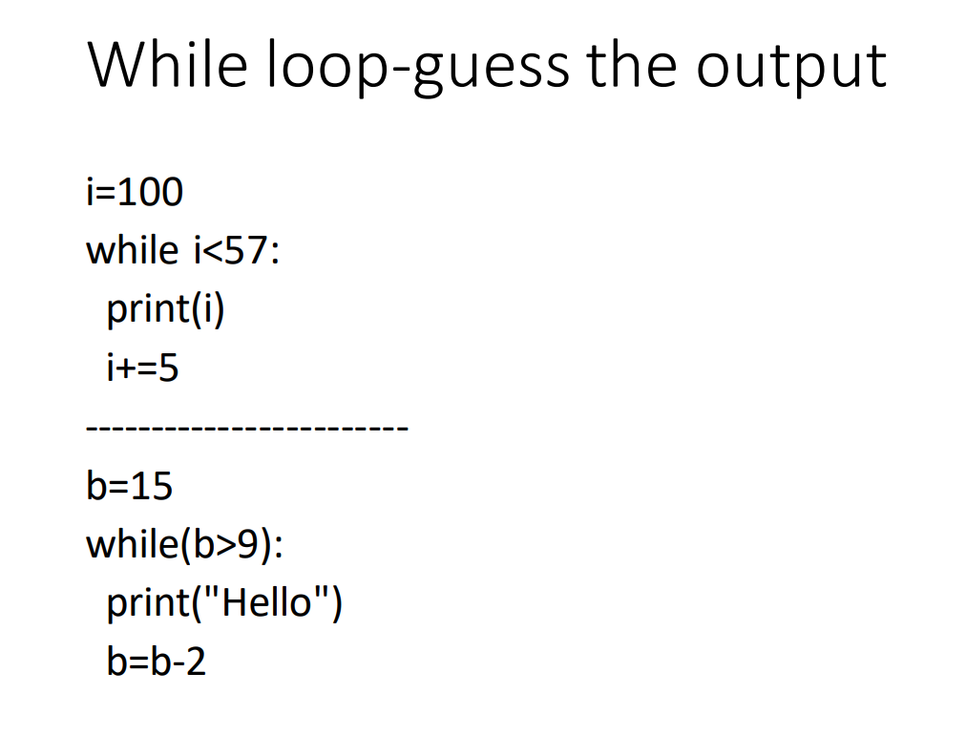

Slide 93
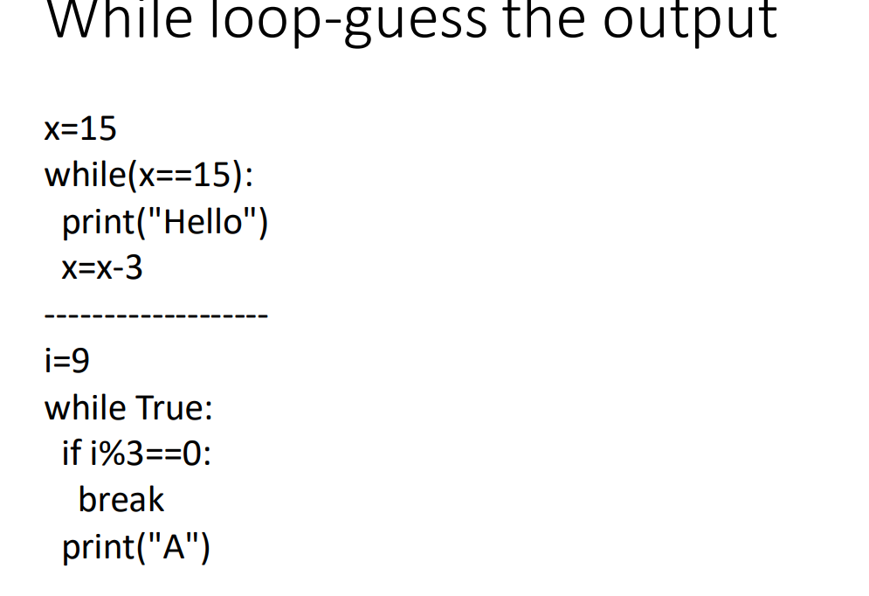

Slide 94
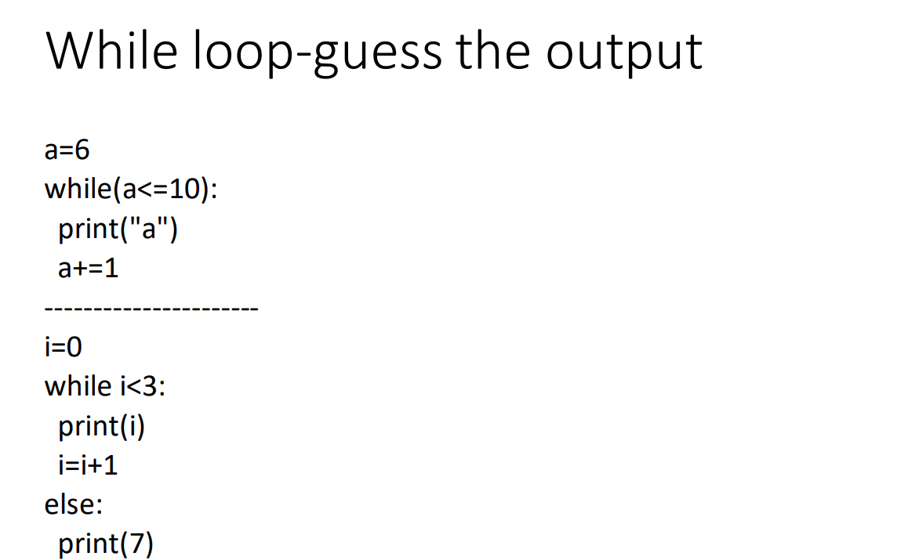

Slide 95
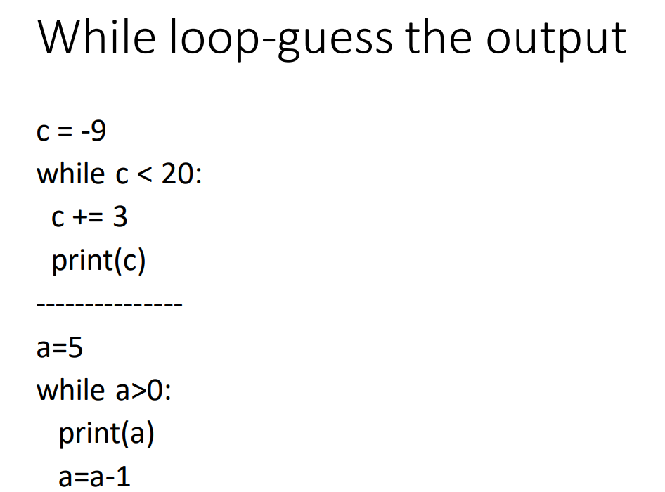

Slide 96
